Slide 1

Domain: MATLAB
Technology: COMMUNICATION
IMPLEMENTATION OF MULTIHOP PROTOCOL WITH COST FUNCTION FOR DECREASING ENERGY CONSUMPTION IN NODES

Slide 2
Index
Abstract
Introduction
Literature review
Existing Method
Disadvantages
Proposed method
Advantages
Hardware and Software Requirements
Results
Conclusion
References

Slide 3
Abstract
We present a routing protocol for Wireless sensor Networks that is reliable, power efficient, and has a high throughput (WSNs). To reduce energy consumption and increase network longevity, we employ a multi-hop topology. To identify the parent node or forwarder, we offer a cost function. The proposed cost function chooses a parent node with the highest residual energy and the shortest distance to the sink. The residual energy parameter balances energy consumption across sensor nodes, while the distance parameter guarantees packet delivery to the sink is successful.
Our suggested approach decreases the energy consumption of nodes which helps in maximizing the network lifetime.
Keywords-- Wireless Sensor Network, Cost Function, energy consumption

Slide 4
Introduction:
Technology advancements have created a numerous chances for resource efficiency in critical environments. In this context, Wireless Sensor Networks (WSNs) have ushered in a revolution. With the development of this technology, it became possible to collect and distribute useful information to the desired location [1]. These schemes can be used to monitor applications such as battlefield surveillance, smart offices, traffic monitoring, and so on.
Sensor nodes in WSNs are powered by a finite amount of energy. Data transmission from sensor nodes to sink must use the least amount of power possible. Battery recharge is one of the most difficult challenges in WSN. To address the problem of battery recharging, an efficient routing protocol is necessary. WSN technology [4], proposes a number of energy-efficient routing methods.
For WSN, we present a routing protocol that is high throughput, reliable, and stable. In a given area, we set up sensor nodes. Near the sink, sensors are positioned. Because sensors carry data and require low attenuation, great reliability, and extended life, they always send data directly to the sink. Other sensors track their parent node and send data to the sink via the forwarder node. It conserves node energy and allows the network to operate for longer.

Slide 5
Literature review:
S. NO | Journal Type with year | Authors | Title | Outcomes
1 | 2012 15th International Multitopic Conference (INMIC). | T. Shah, N. Javaid, T. N. Qureshi | Energy Efficient Sleep Awake Aware (EESAA) Intelligent Sensor Network Routing Protocol | Studied about the (EESAA) intelligent routing protocol for WSNs.
2 | System Sciences, 2000. Proceedings of the 33rd Annual Hawaii International Conference on. IEEE, 2000. | Heinzelman, Wendi Rabiner, Anantha Chandrakasan, and Hari Balakrishnan | Energy-efficient communication protocol for wireless microsensor networks | Studied about LEACH (Low-Energy Adaptive Clustering Hierarchy).
3 | Proc. Wireless Communications and Mobile Computing Conference, 2011, pp. 842–847. | Y. Ebrahimi and M. Younis | Using deceptive packets to increase base station anonymity in Wireless Sensor Network | Studied about boosting the anonymity of the base-station
4 | Proceedings of the 1st ACM international workshop on Wireless sensor networks and applications. ACM, 2002. | aring, Alan, et al | Wireless sensor networks for habitat monitoring | Studied about the requirements for habitat monitoring.
5 | 2nd IEEE Saudi International Electronics, Communications and Photonics Conference (SIECPC 13), 2013, Riyadh, Saudi Arabia. | N. Javaid, U. Qasim, Z. A. Khan, M. A. Khan, K. Latif and A. Javaid | On Energy Efficiency and Delay Minimization in Reactive Protocols in Wireless Multi-hop Network | Studied about NS2 tool, Linear Programming models (LP_models)

Slide 6
Existing methods:
Improved energy-efficient clustering protocol (IEECP) The proposed protocol reduces and balances the energy consumption of nodes by improving the clustering structure, where IEECP is suitable for networks that require a long lifetime. The evaluation results prove that the IEECP performs better than existing protocols.
First, an optimal number of clusters is determined for the overlapping balanced clusters. Then, the balanced-static clusters are formed on the basis of a modified fuzzy C-means algorithm by combining this algorithm with a mechanism to reduce and balance the energy consumption of the sensor nodes. Lastly, cluster heads (CHs) are selected in optimal locations with rotation of the CH function among members of the cluster based on a new CH selection-rotation algorithm by integrating a back-off timer mechanism for CH selection and rotation mechanism for CH rotation.
The proposed protocol which consists of three parts: determination of the optimal number of clusters based on a modified mathematical model, formation of balanced clusters based on a modified Fuzzy C-means (M-FCM) and selection and rotation of the CH for clusters based on the CH selection-rotation algorithm (CHSRA).

Slide 7
Disadvantages in Existing methods:
1. Complexity.
2. More energy consumption.
3. Nodes that are farther from the base station will need more hops or more energy to send their packets.
4. Selecting nodes for multiple hops takes more time results in delay.
5. Back-off timer algorithm will update CHs when the time threshold is reached even when they have packets to be sent.

Slide 8
Proposed method:
A new technique to reduce energy use while increasing throughput.
Our contribution consists of the following:
The stability period of our proposed scheme is longer. Nodes are able to stay alive for longer periods of time while using the least amount of energy possible.
High throughput is aided by a long stability period and low node energy consumption.
We deploy numerous nodes in a region under this scheme. The power and compute capability of all sensor nodes are identical.
Two nodes are chosen, and these two nodes will transport data directly to the sink
A. Proposed Protocol:
First Phase
Forwarder Node Selection
Scheduling

Slide 9
A) Proposed Protocol:
We deploy numerous nodes in a region under this scheme. The power and compute capability of all sensor nodes are identical.
Two nodes are chosen, and these two nodes will transport data directly to the sink.
a) First phase:
During this phase, the sink sends out a brief data packet containing the sink's location in the area. Each sensor node stores the location of sink after receiving this control message. Each sensor node sends out a data packet that includes the node's ID, position in the area, and energy status. All sensor nodes are updated with the location of their neighbors and sink in this manner.
b) Forwarder Node Selection:
We designed a multi-hop approach for WSN in order to save energy and increase network throughput. The conditions for a node to become a parent node or forwarder are presented in this section. Proposed protocol elects a new forwarder in each round in order to balance energy consumption across sensor nodes and reduce network energy usage.
The ID, distance, and remaining energy status of the nodes are all known to the sink node. Sink calculates all nodes' cost functions and sends them to all nodes.

Slide 10
Every node determines whether or not to become a forwarder node based on this cost function. If n is the number of nodes, the following is the cost function for n nodes:
C.F (n)=(d(n))/(R.E(n))
Data is gathered and sent to the sink via the forwarder node. Because the forwarder node has the most residual energy and travels the shortest distance to the sink, it uses the least amount of energy to send data there. Two chosen nodes interact directly with the sink and are not involved in data transmission.
c) Scheduling:
The forwarder node provides time slots to its progeny nodes using Time Division Multiple Access (TDMA) in this phase. Every child node sends its detected data to the forwarder node at a predetermined time. A node enters idle mode when it has no data to send. Only during transmission time do nodes wake up. The energy dissipation of individual sensor nodes is minimized when sensor nodes are scheduled. Performance metric of the proposed method is Energy consumption of nodes, here we use the residual energy parameter to study network energy consumption in order to investigate the energy consumption of nodes every round

Slide 11
First Phase
Sink broadcasts its location through short information packet
Sensor nodes store the location of sink
Each sensor transmits short information packet to sink which contains node ID, its residual energy and location
Sink broadcasts information to all sensors

Slide 12
Forwarder Node Selection
Minimum cost function value is used to select optimal data forwarder
A node with high residual energy and less distance to sink has minimum cost function
Cost Function (i) = distance (i) /Residual Energy (i)
Cost function value ensures new forwarder in each round

Slide 13
Scheduling
Forwarder node assigns TDMA schedule to its children node
Children nodes transmit their data in allocated time slot
TDMA scheduling saves energy of sensor nodes.

Slide 14
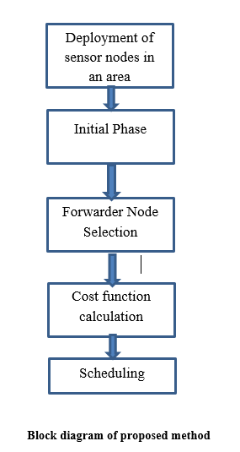
BLOCK DIAGRAM

Slide 15
Advantages of Proposed method:
1. Less Complexity
2. Less energy consumption
3. Selects the nodes efficiently for multi-hops
4. Minimize the multi hop cost consumption
5. Makes more percentage of sleep nodes than the existing methods or protocols
6. Sleep nodes makes network withstand for longer periods than existing protocols

Slide 16
Applications:
1.Industrial control
2.Environmental monitoring,
3. Military surveillance,
4.Intelligent transportation systems and medical field.
5.Furthermore, it can function independently in harsh or high-risk places where human presence is not possible
6.Disaster relief operations.
7.Biodiversity mapping
8.monitoring of temperature, pressure, and humidity

Slide 17
Hardware and Software Requirements:
Hardware & Software Requirements:
Software: Matlab R2018a.
Hardware:
Operating Systems:
• Windows 10
• Windows 7 Service Pack 1
• Windows Server 2019
• Windows Server 2016
Processors:
Minimum: Any Intel or AMD x86-64 processor
Recommended: Any Intel or AMD x86-64 processor with four logical cores and AVX2 instruction set support
Disk:
Minimum: 2.9 GB of HDD space for MATLAB only, 5-8 GB for a typical installation
Recommended: An SSD is recommended a full installation of all Math Works products may take up to 29 GB of disk space
RAM:
Minimum: 4 GB
Recommended: 8 GB

Slide 18
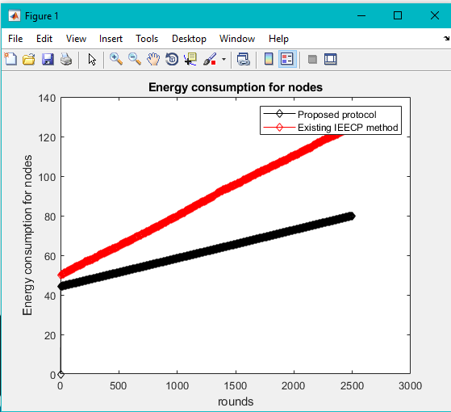
Results and Discussions:
We compared the proposed protocol's performance to that of the existing IEECP protocol.
Figure : Energy consumption for effective network

Slide 19
Comparison of Both Protocols
Method | FND | HND | LND
IEECP | 1244 | 2133 | 2292
Proposed | 1345 | 2233 | 2491
Table: Comparison of Dead Nodes of Both Protocols
FND – First Node Dead, HND – Half Nodes Dead
LND – Last Node Dead

Slide 20
CONCLUSION:
We propose a data routing mechanism in WSNs in this research. To choose an appropriate route to sink, the suggested scheme uses a cost function. The cost function is determined by the nodes' leftover energy and their distance from the sink. The parent node is chosen by the nodes with the lowest cost function value. Other nodes join the parent node as children and send their data to it. Due to their proximity to the sink, two nodes forward their data directly to it; yet, these two nodes cannot be elected as parent nodes because both sensor nodes contain crucial and important data. It is not necessary for these two nodes to expend energy forwarding data from other nodes.

Slide 21
References:
[1] T. Shah, N. Javaid, T. N. Qureshi, "Energy Efficient Sleep Awake Aware (EESAA) Intelligent Sensor Network Routing Protocol," 2012 15th International Multitopic Conference (INMIC).
[2]Heinzelman, Wendi Rabiner, Anantha Chandrakasan, and Hari Balakrishnan. “Energy-efficient communication protocol for wireless microsensor networks.” System Sciences, 2000. Proceedings of the 33rd Annual Hawaii International Conference on. IEEE, 2000.
[3] Y. Ebrahimi and M. Younis, “Using deceptive packets to increase base station anonymity in Wireless Sensor Network,” in Proc. Wireless Communications and Mobile Computing Conference, 2011, pp. 842–847.
[4] aring, Alan, et al. “Wireless sensor networks for habitat monitoring.” Proceedings of the 1st ACM international workshop on Wireless sensor networks and applications. ACM, 2002
[5] N. Javaid, U. Qasim, Z. A. Khan, M. A. Khan, K. Latif and A. Javaid, “On Energy Efficiency and Delay Minimization in Reactive Protocols in Wireless Multi-hop Network”, 2nd IEEE Saudi International Electronics, Communications and Photonics Conference (SIECPC 13), 2013, Riyadh, Saudi Arabia.

